Slide 1
Production Function
Dr. Jalandhar Pradhan

Slide 2
Theory of Production
Production involves transformation of inputs such as capital, equipment, labor, and land into output - goods and services
In this production process, the manager is concerned with efficiency in the use of the inputs
  - technical vs. economical efficiency

Slide 3
Two Concepts of Efficiency
Economic efficiency:
  occurs when the cost of producing a given output is as low as possible
Technological efficiency:
  occurs when it is not possible to increase output without increasing inputs

Slide 4
Production Function
A production function is purely technical relation which connects factor inputs & outputs. It describes the transformation of factor inputs into outputs at any particular time period.
Q = f( L,K,R,L_{d},T,t)
  where
  Q = output R= Raw Material
  L= Labour L_{d} = Land
  K= Capital T = Technology
  t = time
For our current analysis, let’s reduce the inputs to two, capital (K) and labor (L):
Q = f(L, K)

Slide 5
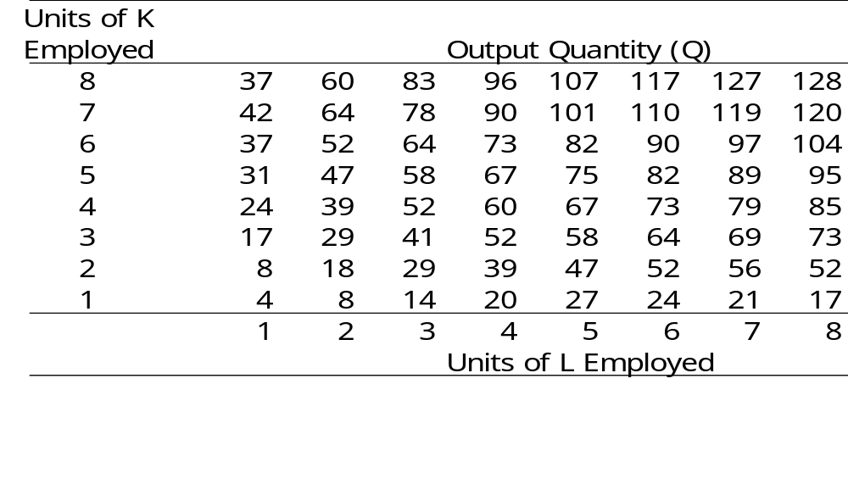
Production Table
Same Q can be produced with different combinations of inputs, e.g. inputs are substitutable in some degree

Slide 6
Short-Run and Long-Run Production
In the short run some inputs are fixed and some variable
  e.g. the firm may be able to vary the amount of labor, but cannot change the amount of capital
  in the short run we can talk about factor productivity / law of variable proportion/law of diminishing returns

Slide 7
In the long run all inputs become variable
  e.g. the long run is the period in which a firm can adjust all inputs to changed conditions
  in the long run we can talk about returns to scale

Slide 8

Short-Run Changes in Production
Factor Productivity
How much does the quantity of Q change, when the quantity of L is increased?

Slide 9

Long-Run Changes in Production
Returns to Scale
How much does the quantity of Q change, when the quantity of both L and K is increased?

Slide 10
Relationship Between Total, Average, and Marginal Product: Short-Run Analysis
Total Product (TP) = total quantity of output
Average Product (AP) = total product per total input
Marginal Product (MP) = change in quantity when one additional unit of input used

Slide 11
The Marginal Product of Labor
The marginal product of labor is the increase in output obtained by adding 1 unit of labor but holding constant the inputs of all other factors
Marginal Product of L:
MP_{L}= ΔQ/ΔL (holding K constant)
= δQ/δL
Average Product of L:
AP_{L}= Q/L (holding K constant)

Slide 12
Law of Diminishing Returns
(Diminishing Marginal Product)
The law of diminishing returns states that when more and more units of a variable input are applied to a given quantity of fixed inputs, the total output may initially increase at an increasing rate and then at a constant rate but it will eventually increases at diminishing rates.
Assumptions. The law of diminishing returns is based on the following assumptions: (i) the state of technology is given (ii) labour is homogenous and (iii) input prices are given.

Slide 13
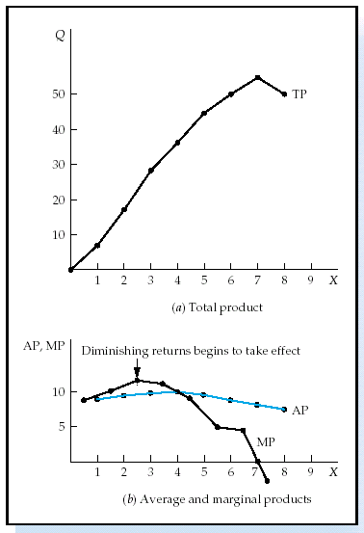
Short-Run Analysis of Total,
Average, and Marginal Product
If MP > AP then AP is rising
If MP < AP then AP is falling
MP = AP when AP is maximized
TP maximized when MP = 0

Slide 14
Three Stages of Production in Short Run
AP,MP
Stage I
Stage III
Stage II
AP_{X}
MP_{X}
X
TP_{L} Increases at increasing rate.
MP Increases at decreasing rate.
AP is increasing and reaches its maximum at the end of stage I
TP_{L} Increases at Diminshing rate.
MP_{L} Begins to decline.
TP reaches maximum level at the end of stage II, MP = 0.
AP_{L} declines
TPL begins to decline
MP becomes negative
AP continues to decline

Slide 15
Application of Law of Diminishing Returns:
It helps in identifying the rational and irrational stages of operations.
It gives answers to question –
How much to produce?
What number of workers to apply to a given fixed inputs so that the output is maximum?

Slide 16
Production in the Long-Run
  All inputs are now considered to be variable (both L and K in our case)
  How to determine the optimal combination of inputs?
To illustrate this case we will use production isoquants.
An isoquant is a locus of all technically efficient methods or all possible combinations of inputs for producing a given level of output.

Slide 17
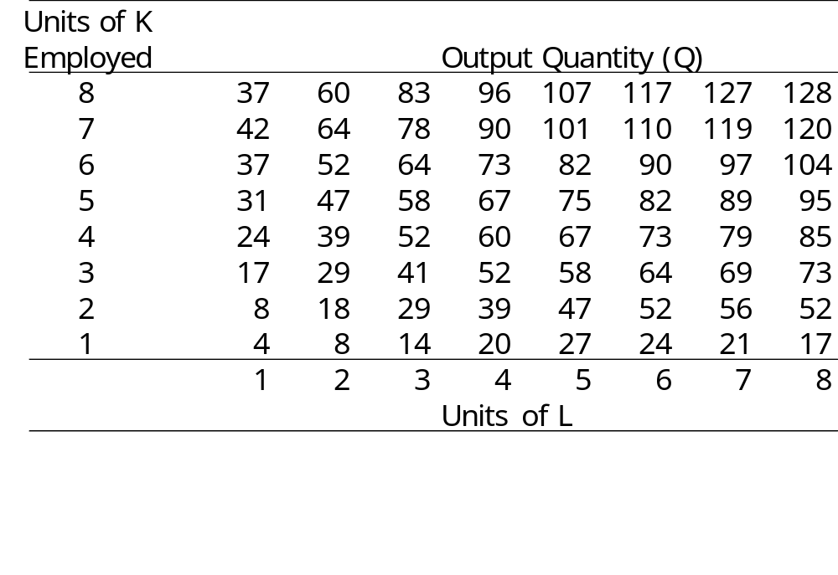
Production Table
Units of K
Employed
Isoquant

Slide 18
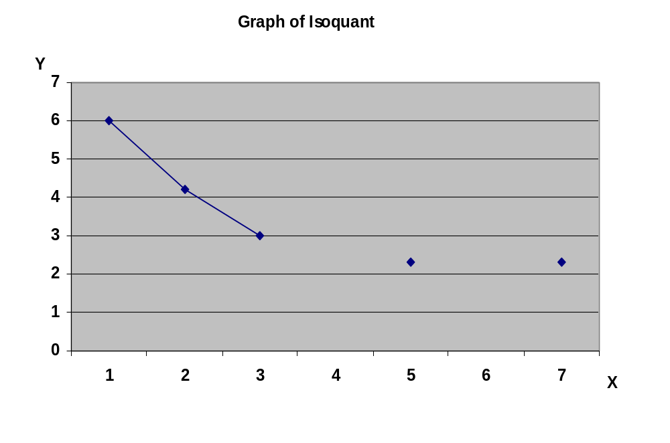
Isoquant

Slide 19
Marginal Rate of Technical Substitution MRTS
The degree of imperfection in substitutability is measured with marginal rate of technical substitution (MRTS- Slope of Isoquant):
MRTS = ΔL/ΔK
(in this MRTS some of L is removed from the production and substituted by K to maintain the same level of output)

Slide 20
Properties of Isoquants
Isoquants have a negative slope.
Isoquants are convex to the origin.
Isoquants cannot intersect or be tangent to each other.
Upper Isoquants represents higher level of output

Slide 21
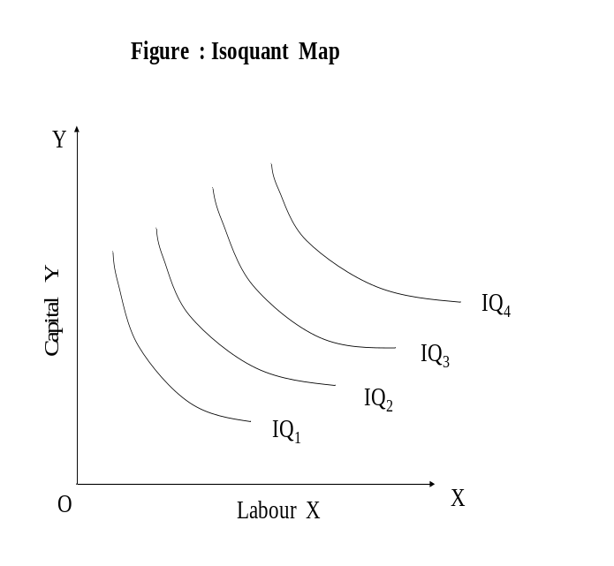
Isoquant Map
Isoquant map is a set of isoquants presented on a two dimensional plain. Each isoquant shows various combinations of two inputs that can be used to produce a given level of output.

Slide 22
Laws of Returns to Scale
It explains the behavior of output in response to a proportional and simultaneous change in input.
When a firm increases both the inputs, there are three technical possibilities –
TP may increase more than proportionately – Increasing RTS
TP may increase proportionately – constant RTS
TP may increase less than proportionately – diminishing RTS

Slide 23
Increasing RTS
K
Product Line
3K
3X
2K
2X
K
X
0
L
2L
3L
L

Slide 24
Constant RTS
K
Product Line
3K
3X
2K
2X
K
X
0
L
2L
3L
L

Slide 25
Decreasing RTS
K
Product Line
3K
3X
2K
2X
K
X
0
L
2L
3L
L

Slide 26
Elasticity of Factor Substitution
() is formally defined as the percentage change in the capital labour ratios (K/L) divided by the percentage change in marginal rate of technical substitution (MRTS), i.e
Percentage change in K/L
()=
Percentage change in MRTS
д(K/L) / (K/L)
()=
д(MRTS) / (MRTS)

Slide 27
Equilibrium of the firm: Choice of optimal combination of factors of prod^{n}
Assumptions:
1. The goal of the firm is profit maximization i.e maximization of difference
  ∏ - Profit
  R- Revenue
  C-Cost
  2. The price of o/p is given, Px
  3. The price of factors are given w is the given wage rate r is given price capital

Slide 28
Single Decision of the firm
(a) Maximize profit ∏, subject to cost constraint. In this case total cost & prices are given and maximization of ∏ is if X is maximised since c & Px are given constant.
        ∏ = R-C
        = P _{x} X-C
(b) Maximise Profit ∏ for a given level of o/p. Maximisation of ∏ is achieved in this case if cost c is minimized , given that X & Px are given constants.
        ∏= R-C
        ∏= P_{x}X - C

Slide 29
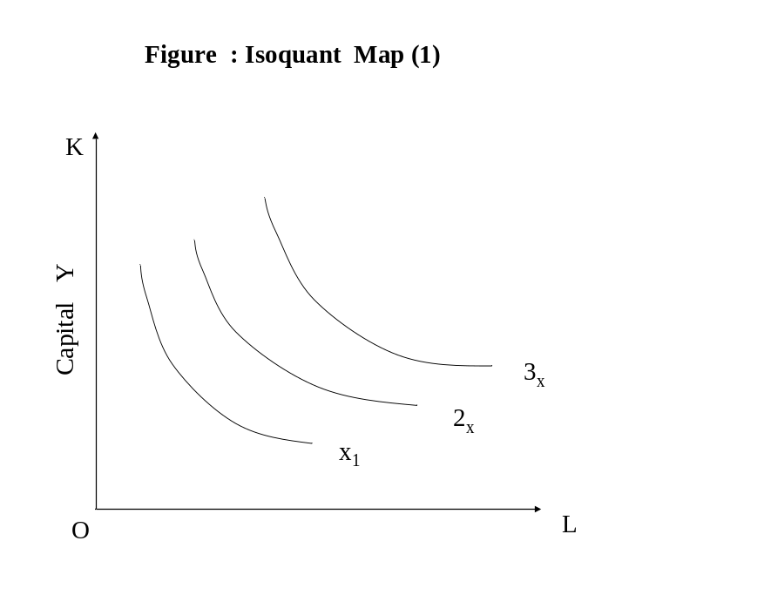
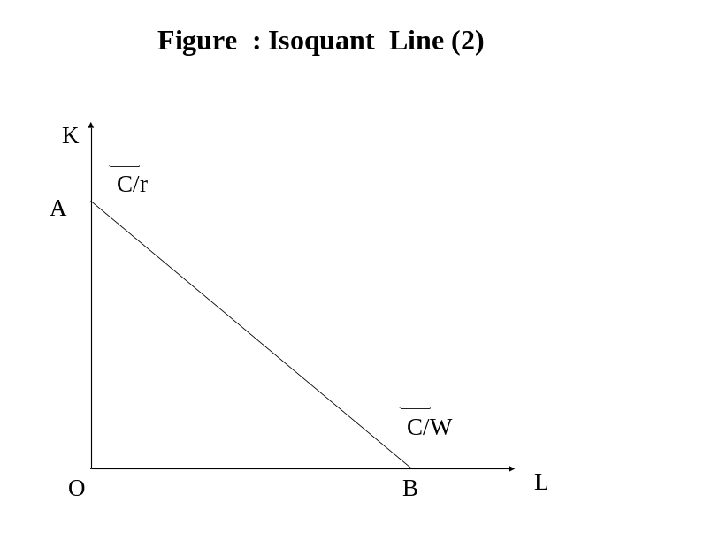
We will use isoquant map (1) and isoquant line (2)
The cost line is defined by cost equation
C= (r) (k) + (w) (L)
W wage rate r= price of capital service

Slide 30
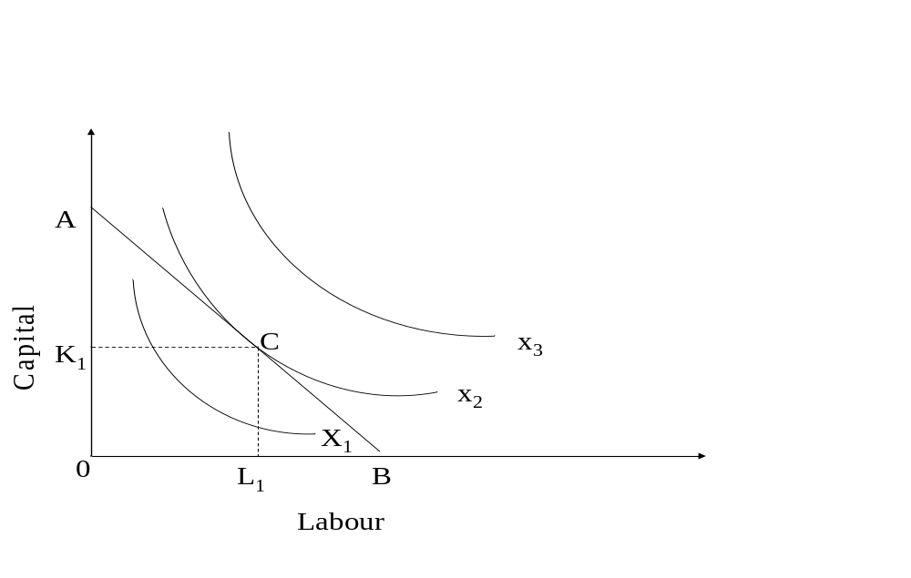
Case I
Maximization of output subject to cost constraint

Slide 31
Condition for Equilibrium
At point of tendency slope of isocost line (w/r ) = slope of isoquant. (MP_{L}/MP_{K})
The isoquants should be convex to origin

Slide 32
Case II
Minimization of cost for given level of output
K
K₁
e
X
0
L₁
L

Slide 33
ISOQUANTS AND ISOCOSTS
NEW LOOK AT TECHNOLOGY: ISOQUANTS
TABLE 1 Alternative Combinations of Capital (K) and Labor (L) Required to Produce 50, 100, and 150 Units of Output
 | Q_{X} = 50 |  | Q_{X} = 100 |  | Q_{X} = 150
 | K | L | K | L | K | L
A B C D E | 1 2 3 5 8 | 8 5 3 2 1 | 2 3 4 6 10 | 10 6 4 3 2 | 3 4 5 7 10 | 10 7 5 4 3
<number> of 33

Slide 34
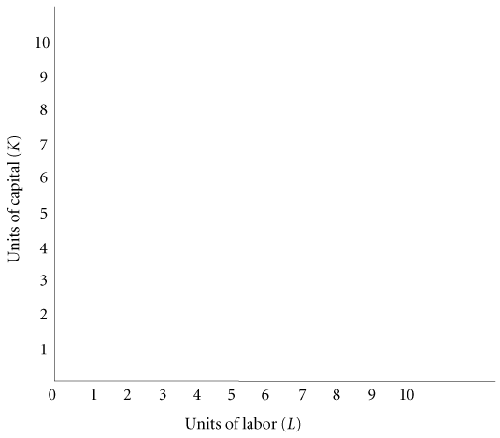
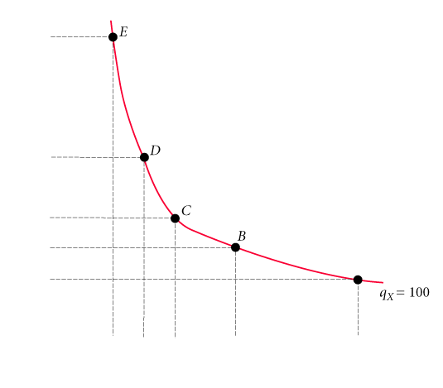
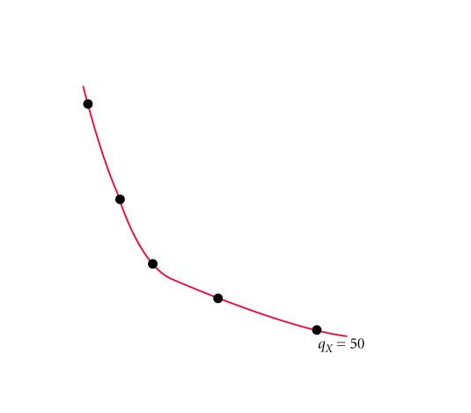
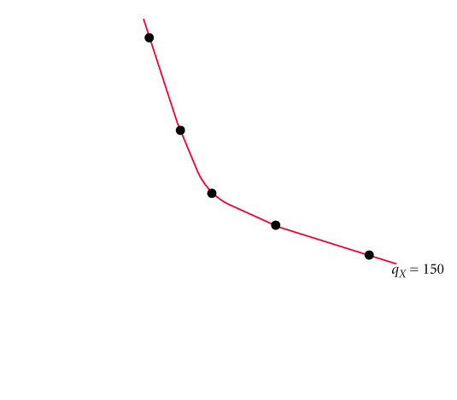
Appendix
Isoquant A graph that shows all the combinations of capital and labor that can be used to produce a given amount of output.
FIGURE 7A.1 Isoquants Showing All Combinations of Capital and Labor That Can Be Used to Produce 50, 100, and 150 Units of Output
<number> of 33

Slide 35
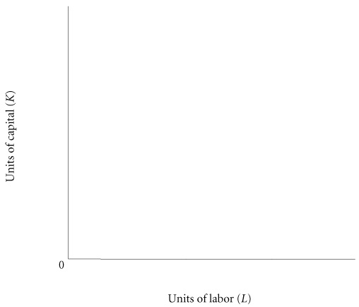
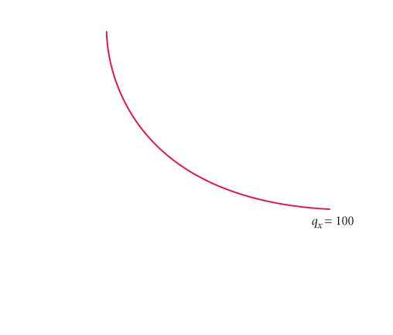
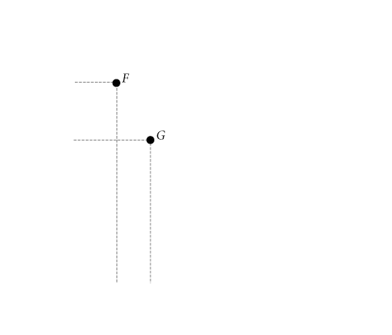
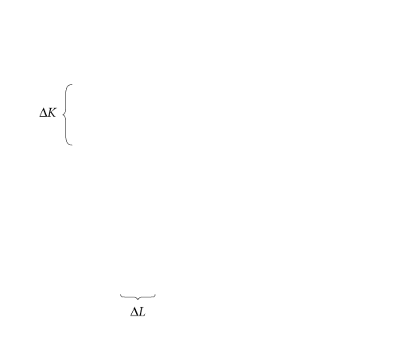
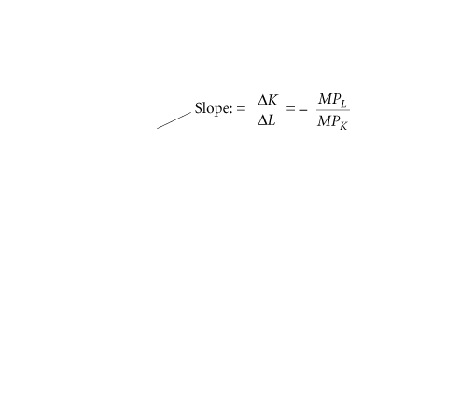
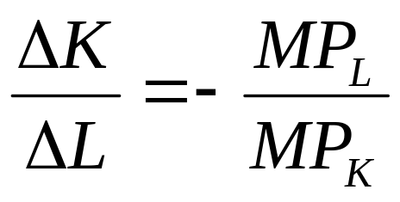
Appendix
Slope of isoquant:
marginal rate of technical substitution The rate at which a firm can substitute capital for labor and hold output constant.
FIGURE 7A.2 The Slope of an Isoquant Is Equal
to the Ratio of MP_{L} to MP_{K}
<number> of 33

Slide 36
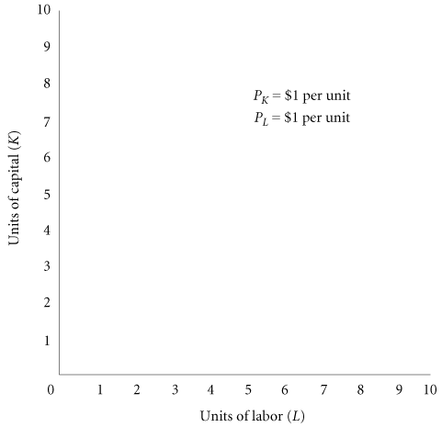
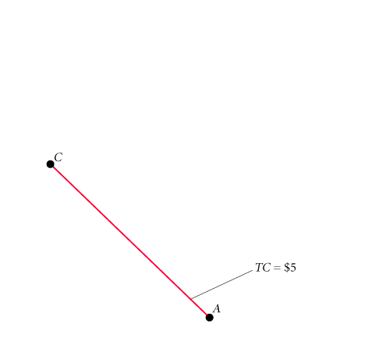
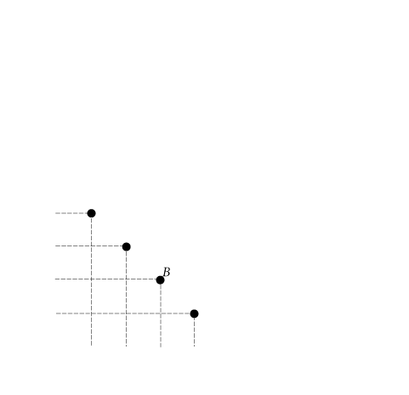
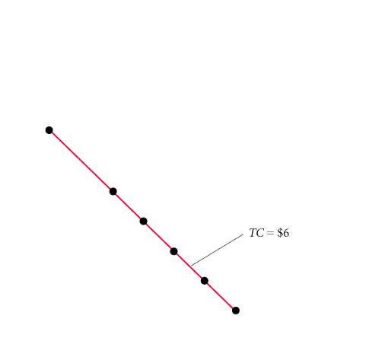
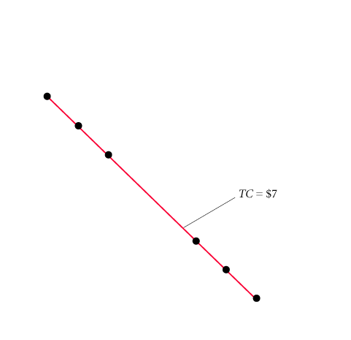
Appendix
FACTOR PRICES AND INPUT COMBINATIONS: ISOCOSTS
isocost line A graph that shows all the combinations of capital and labor available for a given total cost.
FIGURE 7A.3 Isocost Lines Showing the Combinations of Capital and Labor Available for $5, $6, and $7
<number> of 33

Slide 37
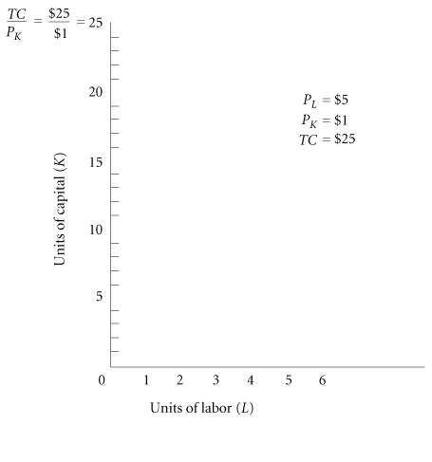
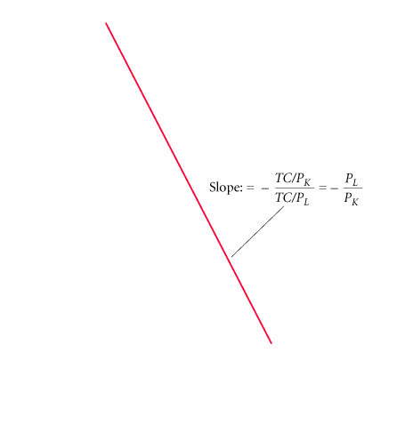
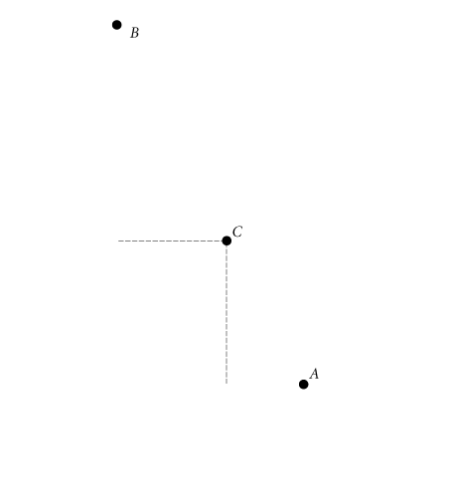
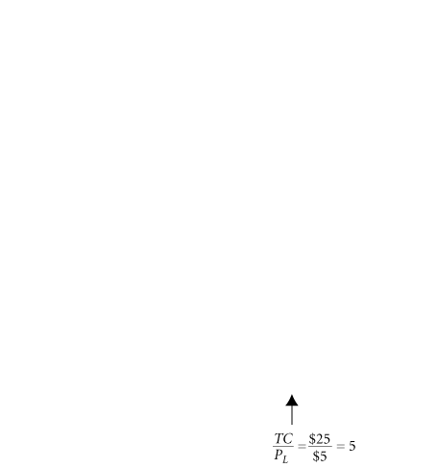
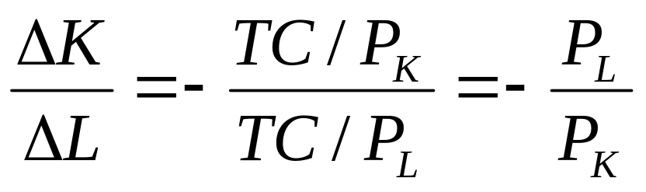
Appendix
FIGURE 7A.4 Isocost Line Showing All Combinations of Capital and Labor Available for $25
Slope of isocost line:
<number> of 33

Slide 38
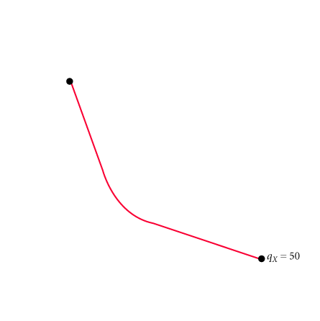
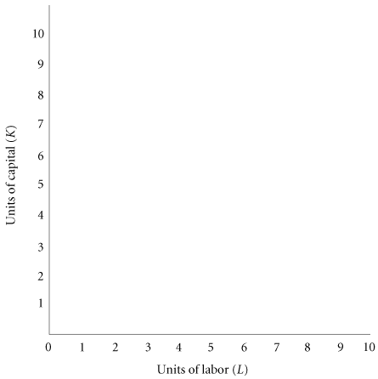
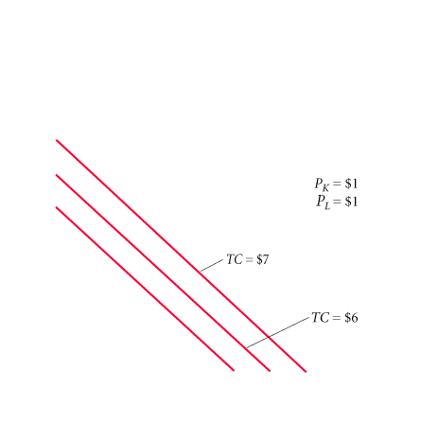
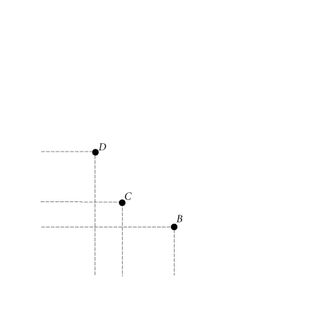
Appendix
FINDING THE LEAST-COST TECHNOLOGY WITH ISOQUANTS AND ISOCOSTS
FIGURE 7A.5 Finding the Least-Cost Combination of Capital and Labor to Produce 50 Units of Output
The firm will choose the combination of inputs that is least costly. The least costly way to produce any given level of output is indicated by the point of tangency between an isocost line and the isoquant corresponding to that level of output.
<number> of 33

Slide 39
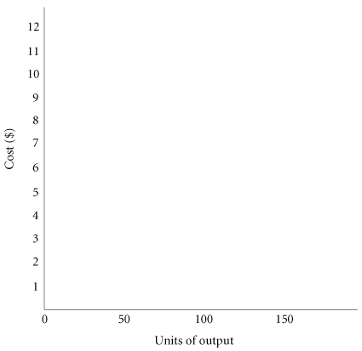
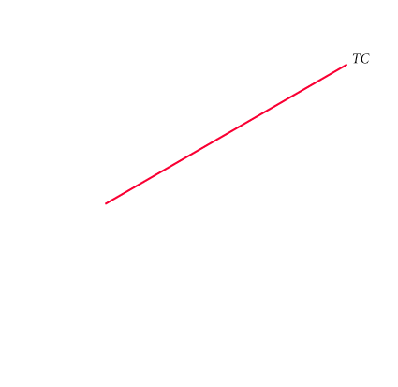
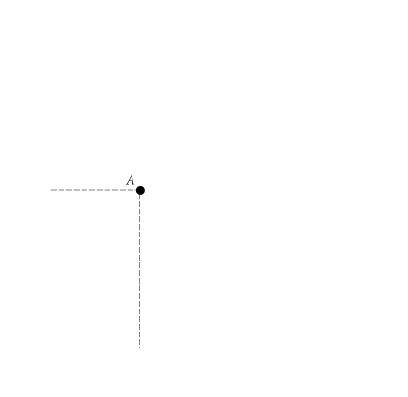
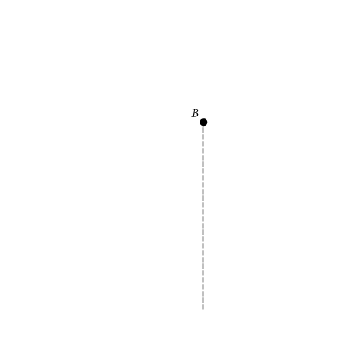
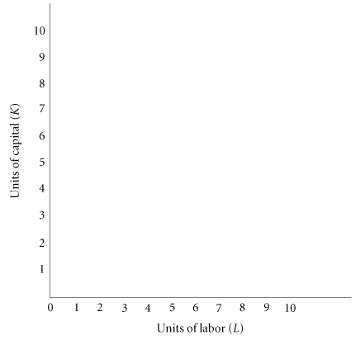
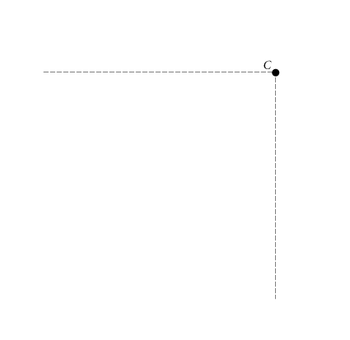
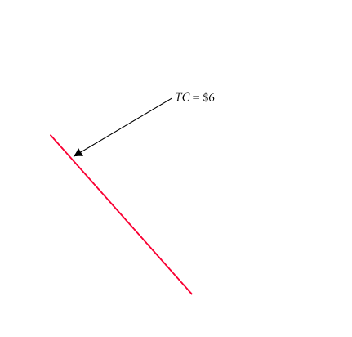
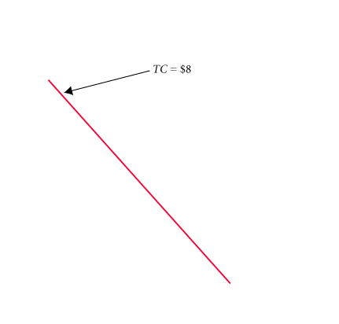
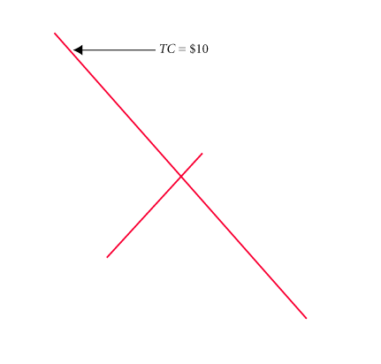
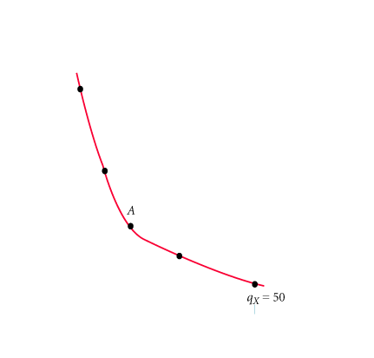
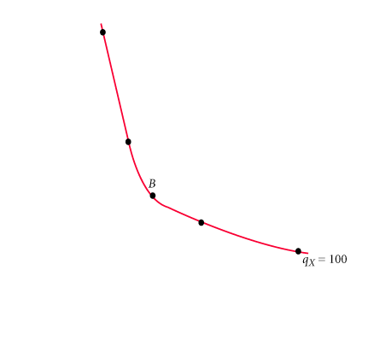
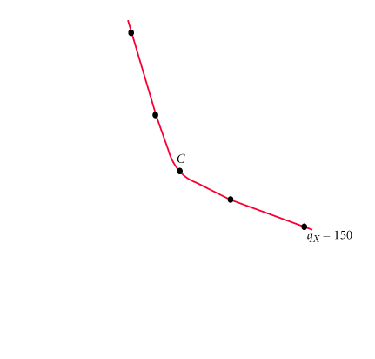
Appendix
FIGURE 7A.6 Minimizing Cost of Production for q_{X} = 50, q_{X} = 100, and q_{X} = 150
FIGURE 7A.7 A Cost Curve Shows the Minimum Cost of Producing Each Level of Output
<number> of 33

Slide 40
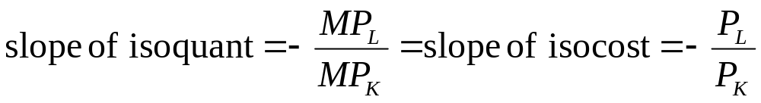
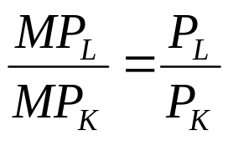
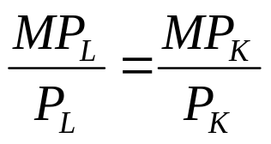
Appendix
THE COST-MINIMIZING EQUILIBRIUM CONDITION
At the point where a line is just tangent to a curve, the two have the same slope. At each point of tangency, the following must be true:
Thus,
Dividing both sides by P_{L} and multiplying both sides by MP_{K}, we get
<number> of 33

Slide 41
Given the following production function and input prices, estimate the the optimum input combination of L and K, assuming that the firm has only Rs. 6000/- to spend. Additionally, assume profit maximization as the objective function of the firm:
Q=LK-80L
P_{L}^{=60, Pk=30}

